Slide 1
Notes on Cyber Ranges
Noah Dunn

Slide 2
Overview
Cyber Ranges is defined generally as a ‘controlled virtual environment’ where Cyber engineers can practice working against very dangerous, very unstable pieces of software
Becoming increasingly popular in Government, Academia, and Industry
History: The first cyber ranges were developed during WWI, confined to secret programs within the DOD, worked exclusively by defense contractors. The labs were analogous to proving grounds, the areas where advanced weapons were tested in the field.
https://www.govtech.com/blogs/lohrmann-on-cybersecurity/cyber-range-who-what-when-where-how-and-why.html

Slide 3
Academia Focus
Two Main Areas of Focus
State + Government Entities: There’s lots of jobs open in Cyber, but very few people who have the ability or skills to get in at the entry level
Academia: Schools want to develop programs that attract students from all over. Cyber ranges provide this for interest as well as satisfying the desires of Point 1. (Most) Students are going to school to get a job, and govt. work has good job security
https://www.govtech.com/blogs/lohrmann-on-cybersecurity/cyber-range-who-what-when-where-how-and-why.html

Slide 4
Making Use of a Cyber Range
For all companies and school pursuing this domain, it appears that there is three notable trains of thought
Design a custom built Cyber Range software solution (Including designing and providing the full network stack)
Use an offline network with written exercises and frequently perform full reinstalls on frequently corrupted boxes/virtual machines in a lab
Use another school’s implementation of Point 1.
Point 1 is only realistic for very large schools willing to dedicate large number of resources, Point 2 is not scalable or feasible for courses larger than a few students and yields a DevOps nightmare. Point 3 is the only realistic choice for Miami

Slide 5
5 Potential Cyber Range Options

Slide 6

U.S Cyber Range
Based on Virginia Cyber Range, developed by the University of Virginia
Developed to offer the coursework to schools outside of Virginia
Provides a repository of modules, lesson plans, and skill challenges for instructors to build custom courses with
255 NICE Skills/Abilities/Knowledge (National Institute of Cybersecurity Education) viewable here
Provides Cloud Infrastructure for all of their modules with the modules loaded
Cost: ~$15 - $20 per student per class per month
Cost: ~$60 - $80 per semester
https://www.uscyberrange.org/features

Slide 7

Ohio Cyber Range
Sponsored by the Ohio Department of Higher Education
Updated as of November 2019, used by Cedarville, Lorain, OSU, UA, OU, UD, and UC
Some material scoped very heavily towards earning popular certificates (CompTIA Network+, Security) in the short term while also offering full courses
Coursework is very structured, with the option of creating and generating custom built modules
General course topics available here, specific modules are viewable at the surface level
Cost/Usage not available without signing up through an institution
Appears to host servers alongside modules and course plans
“OCR is complete s**t but it works” - Mike Gentile
https://www.ohiocyberrangeinstitute.org/

Slide 8

Circadence (Project Ares)
Proprietary solution, award winner for teaching Cyber in 2019
No Instructor based implementation, architecture and classwork is built out completely, with no ability for modification
Cost is not listed, clients can request demos of the software
Promotes usage for Proprietary and Academic solutions
Strongly gamified solution, including a trial available here
https://circadence.com/teach/cyber-security-academic

Slide 9

Cyberbit
Proprietary solution, used by University to construct custom platforms
Teaching available in two forms: Cyber Range and Cyber Labs
Cyber Range - Direct Collection of On-Range attacks to simulate in live time a potential of a cyber attack, with options for viewing benchmarks and response
Cyber Labs - Coordinated, directed, educational exercises similar to a traditional class environment
No Cost available, Live Demo can be requested here
Exercises are all orchestrated around the most modern tech stacks and proprietary software
Used by Purdue University, Miami Dade College, and several popular companies (Sirius, E-Trade, Leidos)
https://www.cyberbit.com/

Slide 10

Maine Cyber Range
Academic solution built using several proprietary software systems
Includes Cyberbit’s Cyber Range, NDG’s NETLAB+ Learning Environment (IT/Network Stack), Digital Forensics (Paraben, Magnet), and a Red Team tool collection
Partnered with a Large number of popular educational proctors and certification distributors (Cisco, CompTIA, Red Hat Academy, etc..)
Site claims that MCR is offered across the United States, contact email available here, cost Unknown
Systems + Architecture Appear provided
https://www.uma.edu/academics/programs/cybersecurity/maine-cyber-range/

Slide 11
Curriculum (Scenario) Development

Slide 12
Architecture Tools (Latest from CMU)
TopGen - Tool for virtualizing offline virtual HTTP, DNS, and mail domains (Offline Internet Simulator)
GreyBox - Built off TopGen, extended capabilities which includes ability to use HTTPS, Transport Layer Security (TLS), and extended networking with Docker
GHOSTS - Framework for creating Synthetic users (Good and Evil acting) to roleplay legitimate server activity scenarios
vTunnel - Allows Tunneling of IP traffic through a Hypervisor to send internet traffic directly to/from a virtual machine
WELLE-D - Emulate wireless networks inside Virtual Machines for experimenting with Pen-Testing
TopoMojo - ASP.NET built framework for setting up and deploying labs/training content
https://insights.sei.cmu.edu/sei_blog/2019/04/six-free-tools-for-creating-a-cyber-simulator.html

Slide 13
The Art of Hacking
Massive Repository put together by Omar Santos
Covers most Cybersecurity topics: Ethical Hacking, Pen Testing, Digital Forensics, Incident Response, Vulnerability Research, Exploit Development, Reverse Engineering
Largest Public Repository encapsulating all the Topics
Corresponding Pearson Video Series that goes in detail on all the content available

Slide 14
Common Course List Topics For Curricula
BLUE
PURPLE
RED
Digital Forensics
Network Security
Encryption
Systems Administration
Bug Bounties
Reverse Engineering
Fuzz Testing
Adversary Emulation
Ethical Hacking
Penetration Testing
Password Cracking
Exploit Development
Metasploit
https://github.com/The-Art-of-Hacking/h4cker

Slide 15
Custom Lab Building
All constructions begin with a choice of image
Kali - King of the Pen Testing Platforms
Parrot - Excellent for both Pen Testing and Security Research
BlackArch - Growing in Popularity, suite of 2300 tools
Pen Tester’s Framework (PTF) - Python script to emulate a Pen Testing Environment
Offensive Docker - Pen Test Suite in a Docker Environment
https://github.com/The-Art-of-Hacking/h4cker/tree/master/build_your_own_lab

Slide 16
Additional Curriculum Deployment
WebSploit Labs - Developed for training sessions at DEFCON, comes packed with 400 exercises and proper setup and installation
Vulnerability Apps - A collections of publicly accessible servers, applications, and environments made intentionally vulnerable to practice on.
PentesterLab - A list of free and paid exercises that work the user through a series of Pentesting labs
https://github.com/The-Art-of-Hacking/h4cker/tree/master/vulnerable_servers

Slide 17
Cloud Based Cyber Ranges
PurpleCloud - Azure based solution with automatic deployment to build a cyber-range on the cloud
SECDEVOPS@CUSE CyberRange - AWS Based Cyber Range
Offensive Docker VPS - Google Cloud based Cyber Range
https://github.com/The-Art-of-Hacking/h4cker/tree/master/build_your_own_lab

Slide 18
Potential Labs to Explore In Class

Slide 19
WebSploit Labs Analysis
Full Websploit suite can be installed from a single command
I ran Kali Linux inside a VirtualBox instance
Command to install:
curl -sSL https://websploit.org/install.sh | sudo bash
Command to update containers:
wget https://websploit.org/update.sh | sudo bash
Command to start Docker if it isn’t already service docker start
Command to get to the correct directory as root:
sudo su -

Slide 20
WebSploit Labs Analysis
As it turns out, this series of exercises is formatted more like a CTF than a formalized lab
Achievement board is present, with specific goals to accomplish, with no explanation of how to accomplish those tasks
This would require the accompaniment of The Art of Hacking video series or written solutions. An example video of Omar Santos solving some of his problems can be found here.
Seems like it could be very helpful, but it would require writing up the solutions ahead of time
Omar Santos has a published guide on the topic with some additional topics and actual fully written walkthroughs here

Slide 21
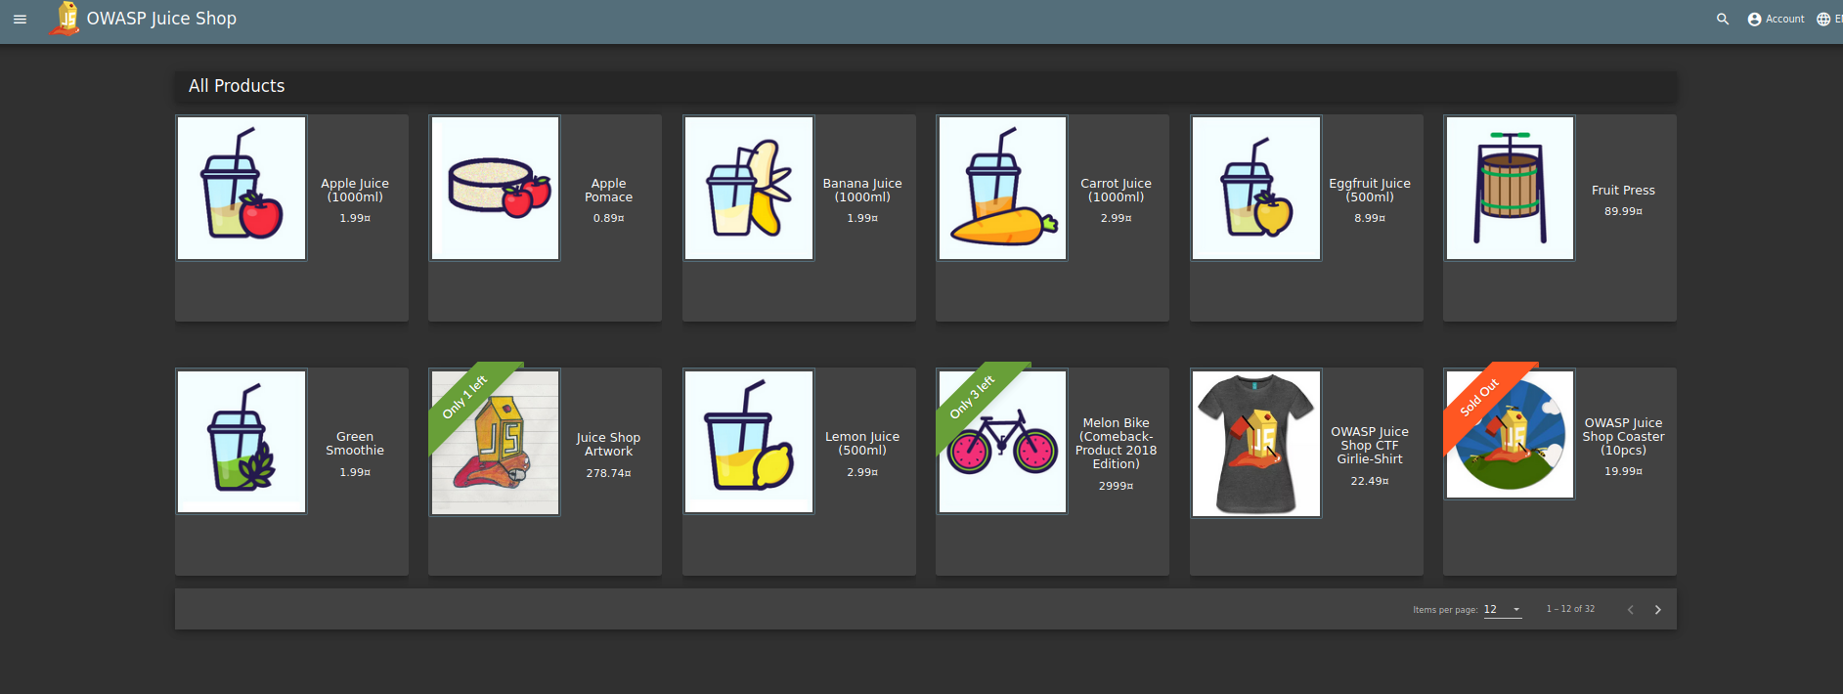
WebSploit Labs Analysis

Slide 22
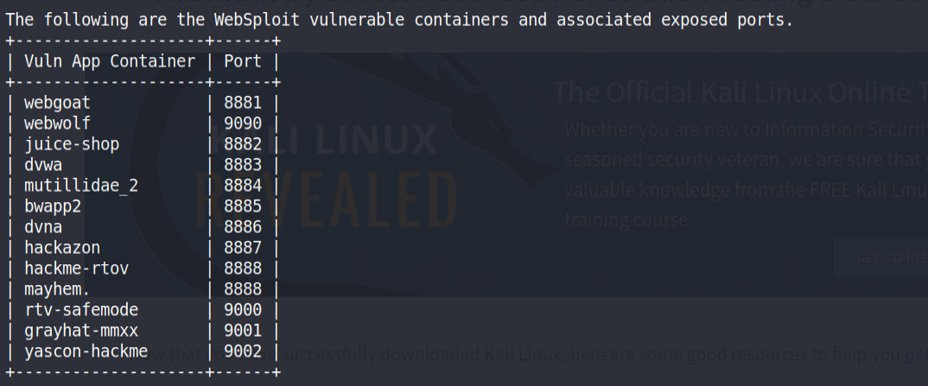
WebSploit Labs Analysis
13 Separate Environments
Many Exercises per Environment

Slide 23
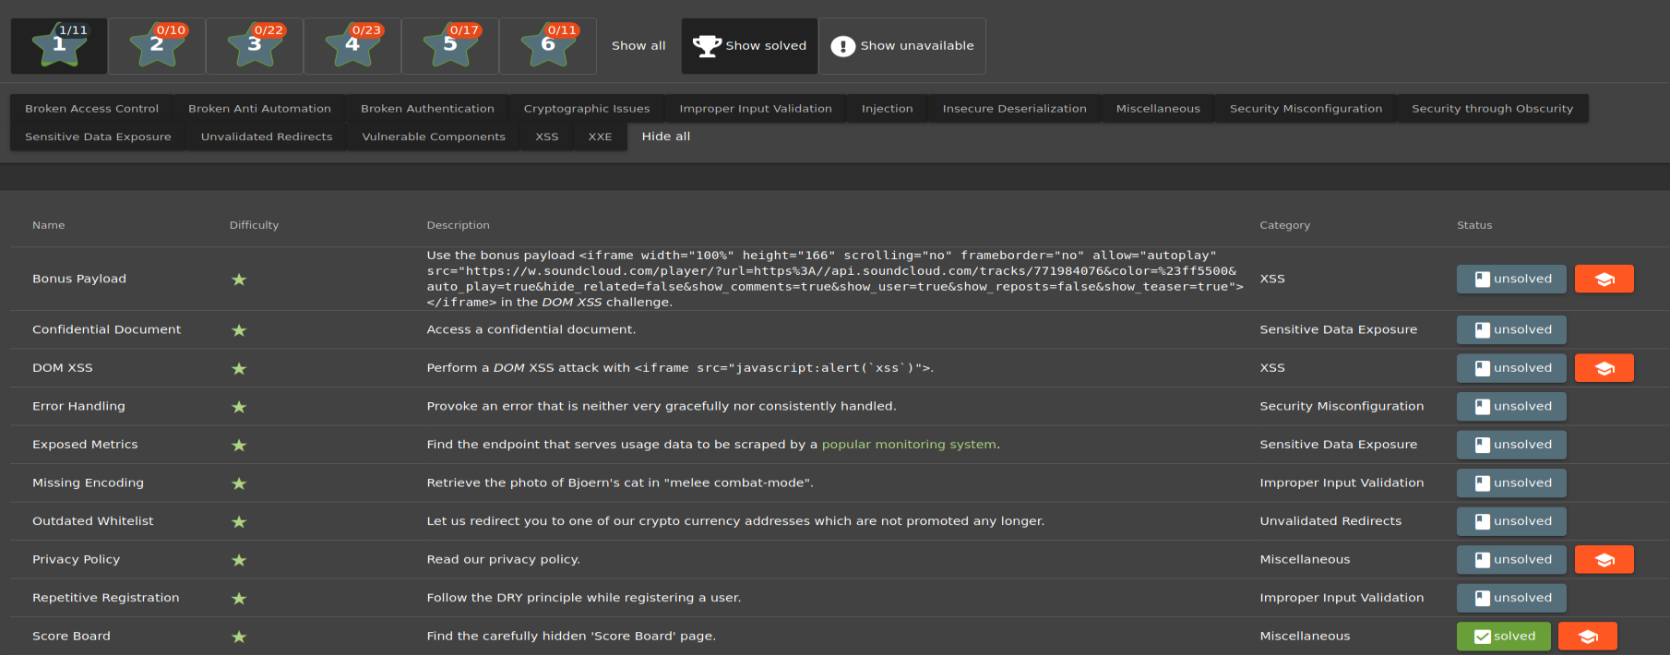
WebSploit Labs Analysis

Slide 24
PentesterLab Exercises
These are architected much more like the format of a standard lab environment
Write-ups entirely done in HTML, makes them easy to read through and portable
~20 exercises in the free tier, some are very short, the ones mentioned here are comprehensive
Many, Many more in the non-free tier
Free tier includes the course walk-through, premium tier accompanies each lab with videos, scoring, additional files. ISO files are provided to load the exercises

Slide 25
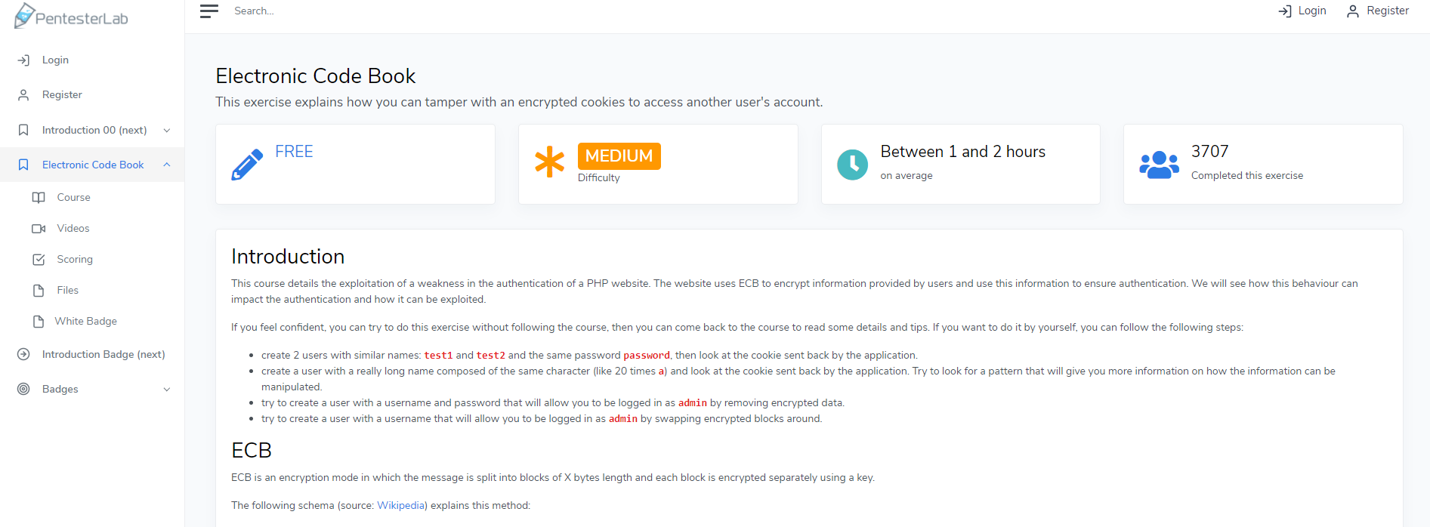
PentesterLab Exercises

Slide 26
PentesterLab: Electronic Code Book
Exercise available here
Rated Medium, taking 1-2 Hours
Explains how Electronic Code Book (ECB) encryption works, which is a PHP authentication attack vector
Walks the user through modifying encrypted cookies in order to access another user’s account
Lab write-up is quite short, but the topics discussed are comprehensive

Slide 27
PentesterLab: Web For Pentester Part 1 and 2
Exercise Part 1 available here, Part 2 available here.
Part 1 covers a plethora of web-based hacking theory
HTTP
HTML Encoding
Cookies and Sessions
Client/Server Security
Fingerprinting
In addition to Part 2 going in detail on the application
SQL Injection
Authentication Page Time Delay
Captcha Breaks
Authorization
Mass Assignment Attacks
Randomness Attacks
Mongo Injection

Slide 28
PentesterLab: SQL Injection To Shell II
Exercise available here
Although the introduction to this exercise focuses on SQL Injection, this is only the brief introduction mechanism.
The meat of this exercise explains how to create a web shell using PHP + HTTP request vulnerabilities
Exercise discusses extension spoofing, payload development, and RCE (Remote Code Execution)

